Slide 1


Occlusion-Based Cooperative Transport with a Swarm of Miniature Mobile Robots
Jianing Chen, Melvin Gauci, Wei Li, Andreas Kolling, and Roderich Groß
Presented by:
Aishwary Jagetia
Sanjuksha Nirgude
Animesh Nema

Slide 2
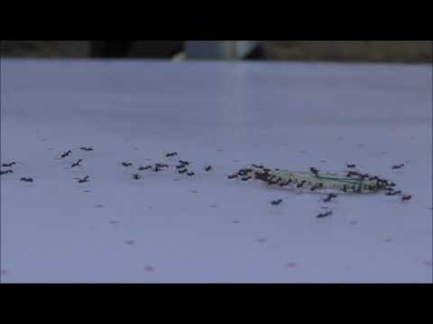
Motivation:
https://www.youtube.com/watch?v=CQihy3DW6yo

Slide 3
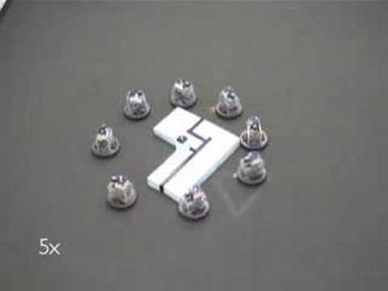
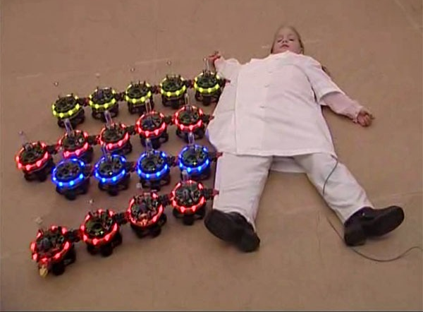
Types of Strategies transport
Pulling
Grasping
Lifting
Complex mechanism
Pushing
Caging
Robots formation
Moved by few robots
Limit on weight of object

Slide 4
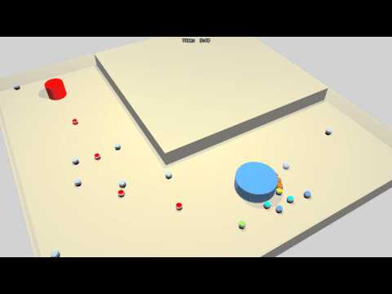
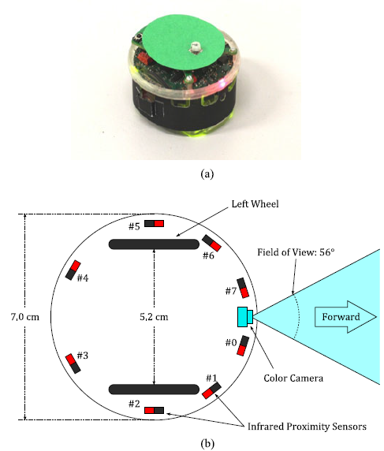
E-pucks at work !
https://www.youtube.com/watch?v=cuONHuqV2GE
Notes:
Decentralized system could be used that relies on inter-robot communication. This may limit the system’s scalability with respect to number of robots.
Convex shaped object are used! Concave might hide the goal for the entire path or might lead to some other directions. Also, robot won’t be able to rotate about the object.
The basic idea is to push the object across the portion of its surface, where it occludes the direct line of sight to the goal.
The e-puck, a differential wheeled robot, has eight infrared proximity sensors (measures at 50 times/second) distributed around its body. It also has directional color camera in the front. E-puck emits infrared light almost continuously which also helps to avoid conclusions.
Potential applications: Delivery of drugs through the vascular network of humans or the removal of debris within narrow fluid.

Slide 5
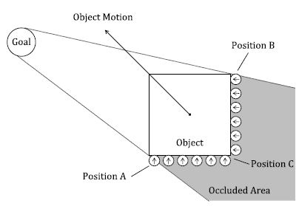
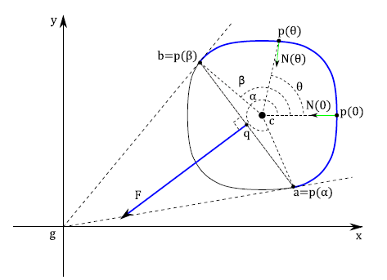
The “Unconventional” Concept
Don't get rid of the obstacle - Occlusion Rocks !
Never Set your eye on the Goal, you’ll eventually get there !
Assumptions:
The object and the goal can each be recognized by the robots.
The dimension of the object is large enough to occlude the robots’ perception of the goal when they are behind it
The robots can perceive the goal from any point within the environment, unless occluded.
Notes:
It is still a problem for robots in cooperative transport to choose good pushing positions and speeds. Increasing the number of pushing robots increases the stability of the object as pushing force is distributed over multiple contact points.
One important property of the method we propose is that neither consistent perception of the goal nor explicit communication are required for robots that are pushing the object. Except for the goal, object and robots the environment is free of obstacles in this experiment.

Slide 6
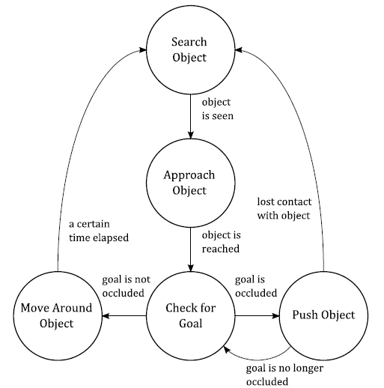
The Magic Trick !
Object moves, occluded surface changes, changing direction of motion.
Keep pushing against occluded surface- reach the GOAL!
This strategy prevents robot from colliding with each other and the boundaries of the environment.
More robots = More likely that they are uniformly distributed
Notes:
All the robots push the object by moving in a direction perpendicular to the object’s surface at their points of contact, the motion of the object will be approximately toward the goal.
As object moves the occluded surface changes thus changing the direction of motion, if the robots only push against the occluded surface then object reaches its goal.
First the robot searches for an object, and performs a random walk. Once the object is seen, robot approaches the object. Once reached, it “Checks for Goal ” to see if the goal can be seen from its position. If not – push the object .
If Yes - “Moving Around Object” , executing a left-hand-wall-following behaviour.
Repeat the process.

Slide 7
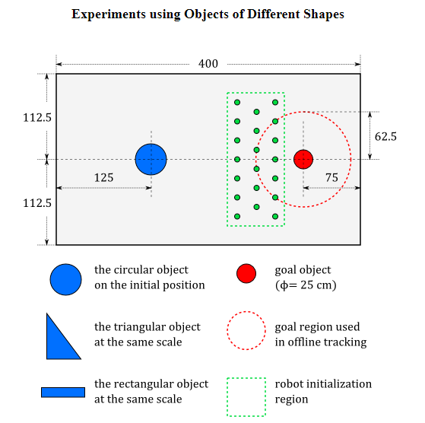
Robot Platform and Sensing
Objects of different shapes
Notes:
Platform: Object is the blue item, Goal is the red item. Robots do random walks and approaches the blue objects. When reached at the object, it does a full rotation to check for the goal, if not seen the continues with the strategy of pushing or moving around. The robots on the extreme points A and B are the only ones who see the goal, they are called the observers. Once an observer, the robot leaves the formation and find another place to push.
Circular Object: At least 3 robots are required to push this object. More prone to collision.
Scalene Triangular Object: Robots can’t push the object in straight line (because the force vector will never pass through the centroid = clockwise or anticlockwise rotation) At least 4 robots are required.
Elongated Rectangular Object: At least 2 robots pushing on the same side.

Slide 8
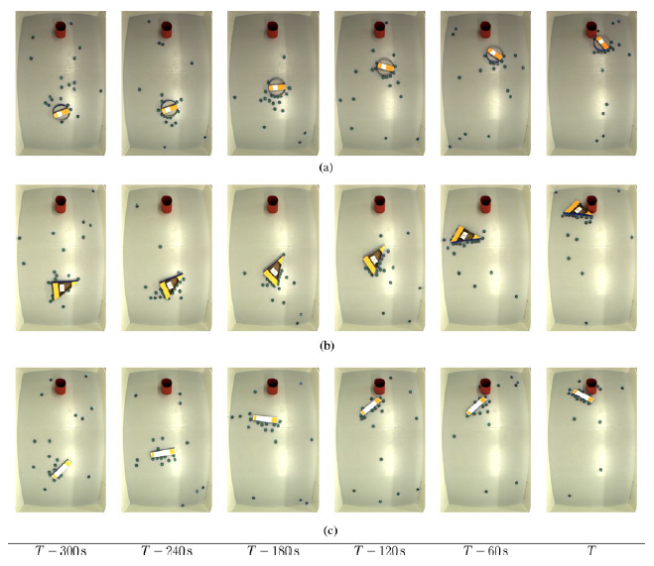
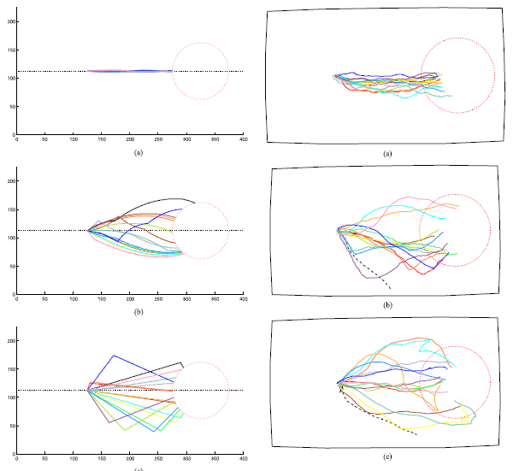
Notes:
A trial was stopped if either of the following situations happened:
1) The object collided with the goal object. The trial was then considered successful.
2) All of the robots stopped automatically due to the 15-min time limit. This means the trial was unsuccessful.
3) The object was too close to the wall and, thus, cannot be transported via pushing anymore. For example, either side of the triangular object fully touched the wall. This means the trial was unsuccessful.

Slide 9
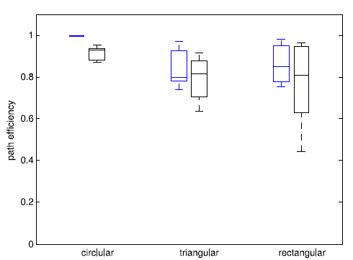
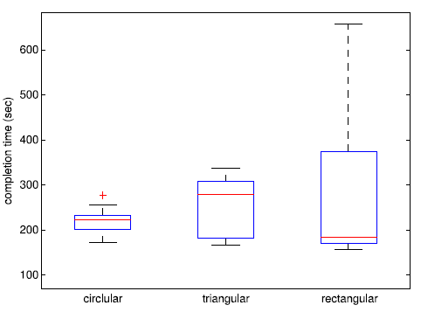
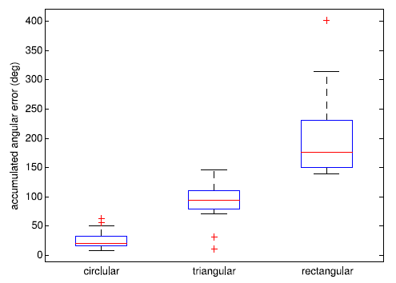

Results
Path efficiency
Completion Time
Accumulated Angular Error
Notes:
Trials : 43 out of 45 trials were completed successfully
Completion time: defined as time of transport of centroid of object from initial position to 62.5 cm away from goal centre. Deviation from goal is larger in case of triangular and rectangular, hence completion time is more.
Path efficiency: It is the ratio of distance between start position and goal region, and the length of the path of the object when its centroid enters the goal region. Ideal transport PE would be 1.
Accumulated Angular Error: Efficiency of pushing the object may be affected if there is unnecessary object rotation, AE is the difference between the relative difference between the initial and final orientations in the trial and the total amount of orientation changes. As due to its elongated shape rectangular object will tend to rotate the most.

Slide 10
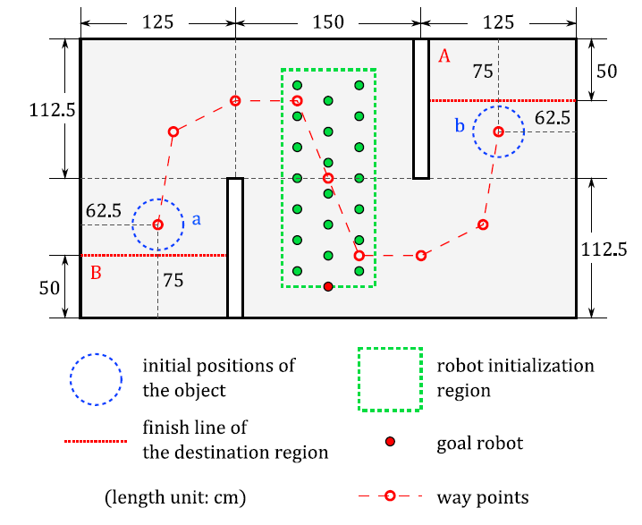
Moving Goal
It is a Teleoperated guided by a human operator via Bluetooth.
It is an extra e-puck robot that moves through series of way points.
The transport strategy is able to deal with a moving goal
Notes:
A teleoperated robot is used as a goal in this experiment. An extra e-puck is used for this purpose, to make it like a goal, a red cylinder is placed over it and all its red LED lights are turned ON. The Arena now consists of the same circular object, but with two walls as the obstacles. The direct line of sight of object’s final position is blocked by the walls.
Human operator moves the goal robot along the designated path. When the distance between the object and the goal robot was very small, the operator moved the goal robot to the next way point. When the object touched the destination region (finish line), the trial was considered successful.

Slide 11
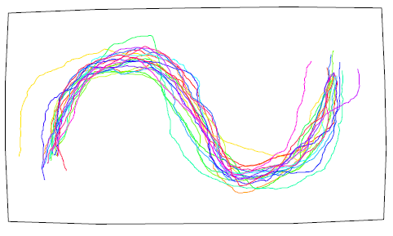
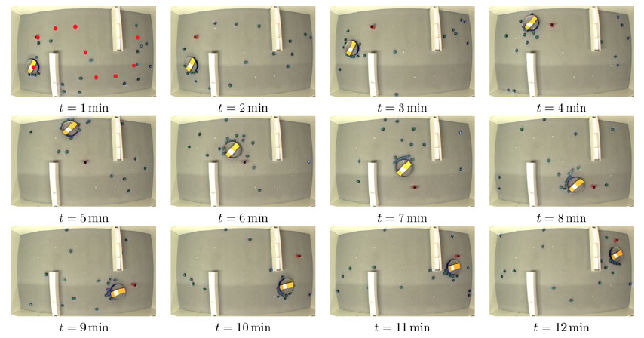
Results
Notes:
Total 20 trials performed – all successful
The object generally did follow the desired path. Hence, the transport strategy is able to deal with the moving goal.

Slide 12
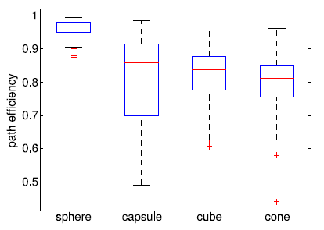
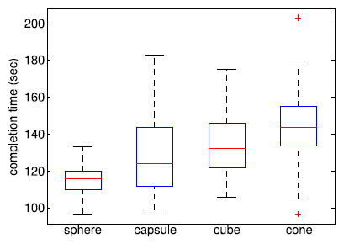
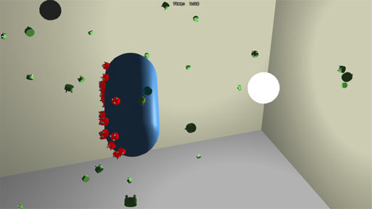
3-D Environment
Conceptual Implementation using Bullet Physics Library
Gravity-less rectangular space
Conceptual robot design
Consistent forces are required for maintaining motion. (eg. Underwater conditions)
GOAL- light source.
“Check for Goal” is not required!
Notes:
The transport strategy has the potential to be implemented in a 3D environment.
The conceptual robot had following description:
I-Long range object sensor
J-Short range object sensor
K- Ambient Light Sensor
W- Obstacle sensor
three thrusts
Motion is randomly chosen at every control cycle following an uniform distribution in the range.
Experiment was performed on sphere, capsule, cone and cube.
400 successful trials!

Slide 13
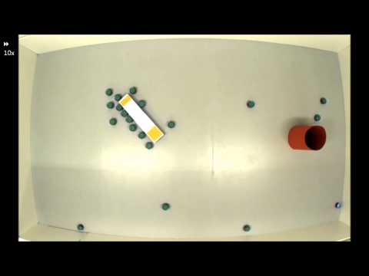
Implementation
https://www.youtube.com/watch?v=NDdlvZTbOaA

Slide 14
Gets you to the goal.
No explicit Communication
Inappropriate for Concave Objects
Decentralized System
Path may not be optimal
Orientation of the object cant be controlled
Disadvantages
Advantages
Notes:
( Robots need not communicate with each other )
(Not sensitive to exact number of robots)
(More robots makes strategy work better.)

Slide 15
Applications:
Removal of Debris within narrow fluid pipelines.
Warehouse facilities.
Drug delivery through vascular network of humans. ( Based on Strategy ).

Slide 16
Conclusion:
The experiment is proven to work very well for transportation of convex objects, but not so much for concave objects.
The object will be transported at the cost of not being able to control its orientation and the path chosen may not be optimal.
The robots work in a decentralized manner and conduct co-operative transport without explicitly communicating with each other.

Slide 17
Thank You!

